Slide 1
IOT integration on a manufacturing system
Lucas Fajardo de Mello
20105493

Slide 2
MQTT communication protocol
Light and fast
Focused on ease of use and implementation
Good performance in low power devices

Slide 3
PubSub standard
Decouples the sender (publisher) from the receiver (subscriber)
Connections are managed by a broker
The broker’s job is to filter and send the messages to the correct subscribers

Slide 4
Client v.s Broker : What is the difference?
Client
Broker
Can be either publishers or subscribers
Any device connected to a broker
Center of the system
Controls all logic behind the message distribution system

Slide 5
Decouplings
Spatial decoupling – Clients do not need to know the details (IP and port) of the receiver.
Temporal decoupling – Clients do not need to be online and operating at the same time.
Sycronizational decoupling – Clients do not need to immediately stop whatever they are doing.

Slide 6
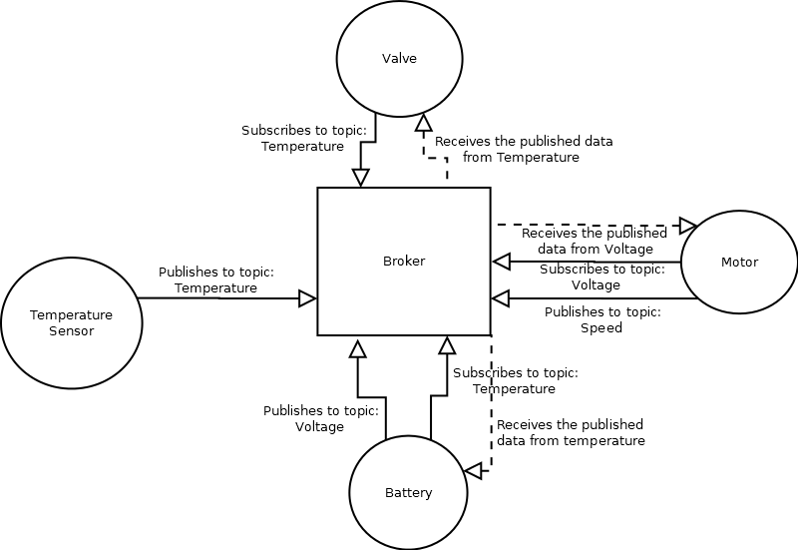
Filtering
Topic based – The client only needs to subscribe to topics of interest

Slide 7
Connecting
ALWAYS between client and broker, two clients never connect between themselves
CONNECT message contains client ID, the username and password for secure brokers, last will message information and if the client wants to re-establish a previous connection or start from a clean one

Slide 8
Subscribing
Only contains the list of topics to which the client is subscribing, and optionally the desired QoS level for each.
Can subscribe to as many topics as needed at once

Slide 9
Publishing
Contains the topic name the message will be published to as well as optionally the QoS level for the message
Published messages can be set as ‘retained’, that basically makes that the default value sent to any cliente that subscribes to the topic
The payload can be absolutely anything, from binary to video

Slide 10
Topics
Simple UTF-8 strings separated in levels with slashes “/”
Created dinamically, no need to declare a topic anywhere before subscribing or publishing to it
E.G. : conveyors/conveyor2/motor1/speed

Slide 11
Wildcards
Serve to simplify complex topic subcription messages
One level (+) – Substitutes only one level of the topic
E.G. : conveyors/conveyor2/+/speed
Multi-level (#) – Substitutes every level above the one specified
E.G. : conveyors/conveyor2/#

Slide 12
QoS levels
Level 0 – “At most once” – Only sends the message
Level 1 – “At least once” – Sends the message and gets a confirmation
Level 2 – “Exactly once” – Sends the message and gets a confirmation and confirms the confirmation

Slide 13
What MQTT implementation ?
Most popular: Hive MQTT
We will not use it though, for our use case a simpler implementation such as Mosquitto is better suited

Slide 14
Why Mosquitto ?
Open-Source
Extra lightweight, good for running on single board computers, like Raspberry Pi
Simple and concise
Great community support

Slide 15
How to start the broker
Open cmd as administrator and CD to installed folder
“net start mosquito”
Standard port is 1883, no need to change
If needed “netstat –a” along with “netstat -ano | findstr :1883” helps find connection information

Slide 16
Publishing and subscribing trough the CLI
CD into the install folder
To subscribe : mosquitto_sub -i <Client_ID> -t <Topic(s)> -d
To publish : mosquitto_pub -i <Client_ID> -t <Topic> -m <Message> -d

Slide 17
Dashboard
Node Red
Simple to use
Handles MQTT input/output well
Nice visuals with easy implementation

